Slide 1
General Motivation
As humans, we are naturally interested in (and sometimes obsessed with) optimization.
However, hardly ever do people’s actions line up with the decisions that would help them achieve their goals.
We know that most things don’t truly act optimally, but what if instead of reemphasizing that in order to improve, we evaluated the beliefs that are held and communicated those to increase understanding of why there might be this optimization gap?
Notes:
When we’re freshman, we optimize our schedule so that all of our classes line up back to back and are near each other, but then in between classes I walk all the way back to the furthest Heritage Halls building to eat lunch.
We plan to optimize our workouts, but then we sit around in between sets and a 45 minute lifting session turns into an hour and a half.
We want to be Christlike, but none of us are actually perfect.

Slide 2
Belief Learning:
Applying Inverse Optimization to the NFL 4th Down Decision
Jacob Miller
Nathan Sandholtz
Brian Hartman

Slide 3
Agenda
4th Down Problem
One of the most hotly debated subjects in football
Forward Optimization
Forward optimization tells us what should be done
Inverse Optimization
Can inverse optimization give us additional insights?
Results
Insights that we can draw from observing hypothetical beliefs

Slide 4
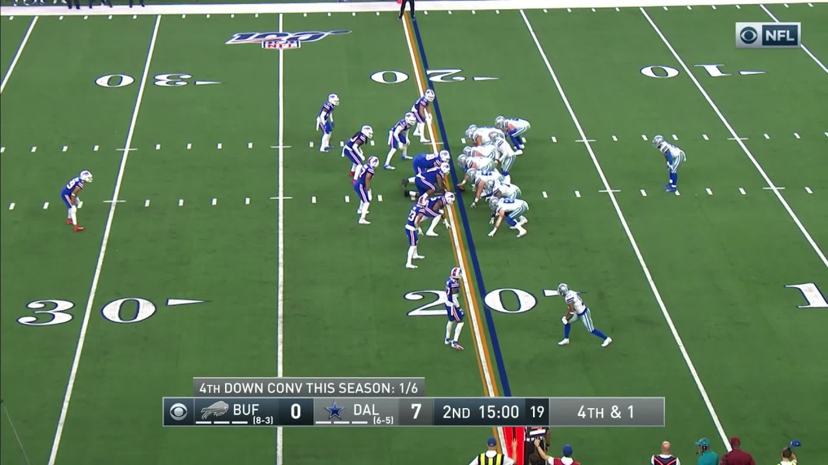
4th DowN “Problem”

Slide 5
4th DowN “Problem”
Traditionally, the decisions made on fourth down have been based on making the “conservative” decision
4th down decisions are often thought of as having high leverage
The problem has gained a lot of popularity in the analytics world – about 1/3 of 4th down decisions made do not agree with the optimal analytical decision
How is the optimal decision determined?
Notes:
For example, the thought of giving up the ball without walking away with points on that possession (if in field goal range) was/is hard to get past and readily criticized on broadcasts and by analysts. Similarly, outside of field goal range, it is much “safer” to punt the ball away rather than risk giving the other team a short field to work with. Additionally, an unsuccessful effort on fourth down could be reason to heavily criticize a coach for their poor decision making, while if the decision results in a win, attention will be drawn to the coach’s foresight and genius.

Slide 6

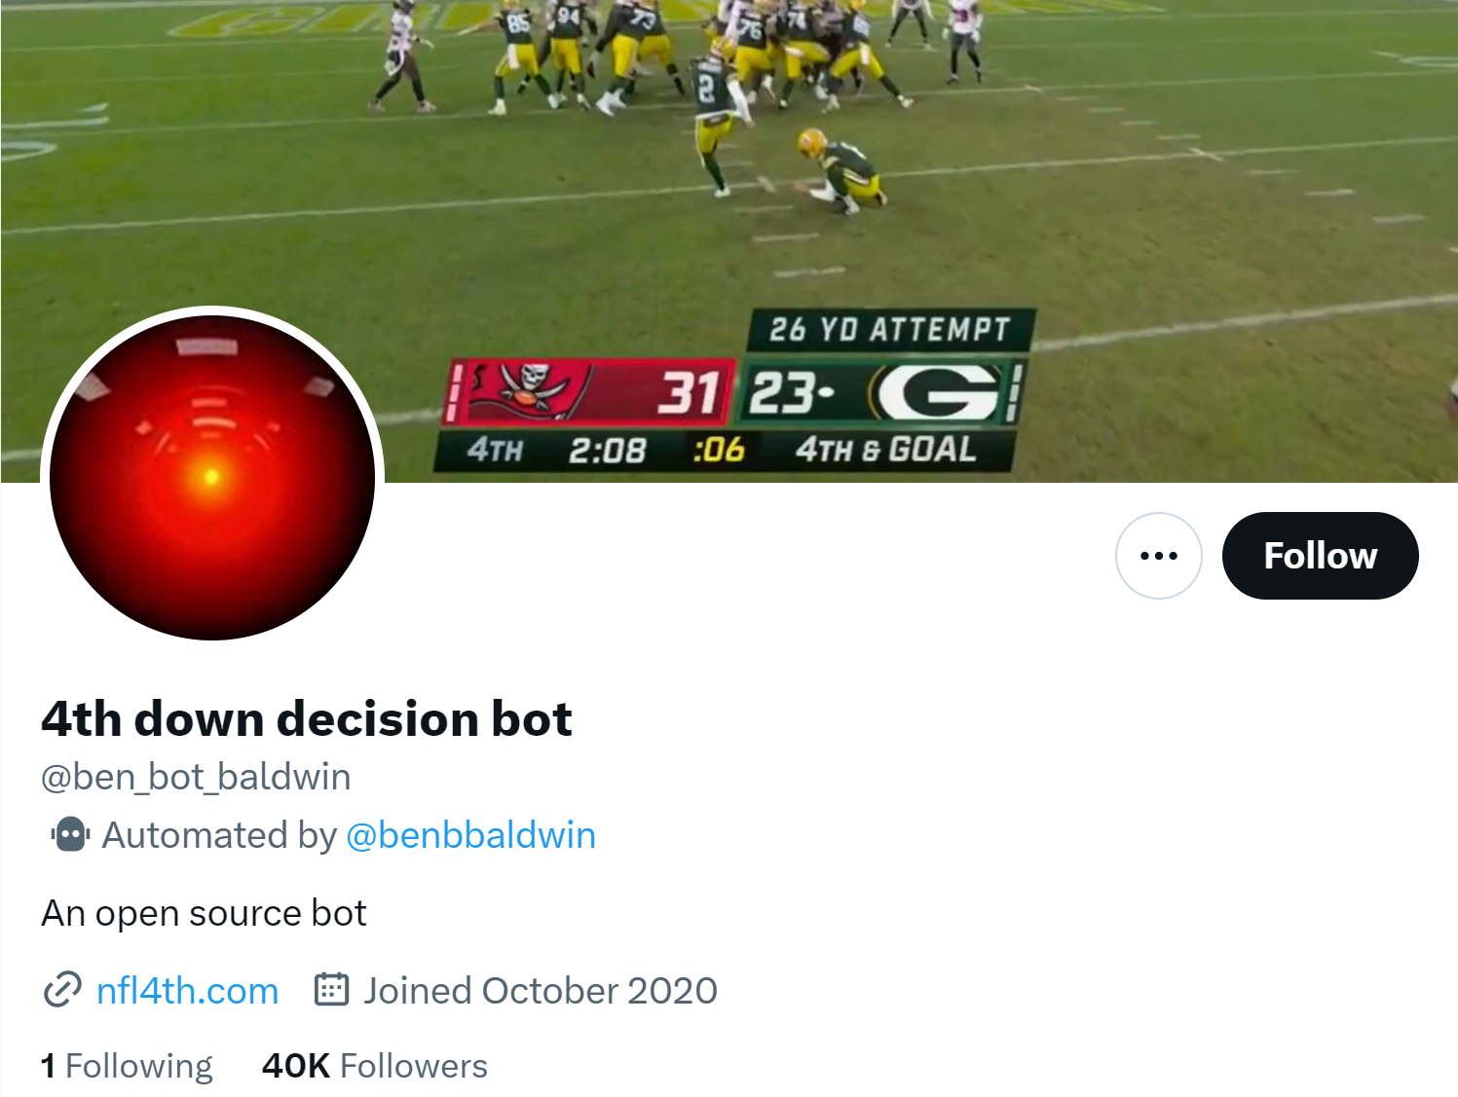
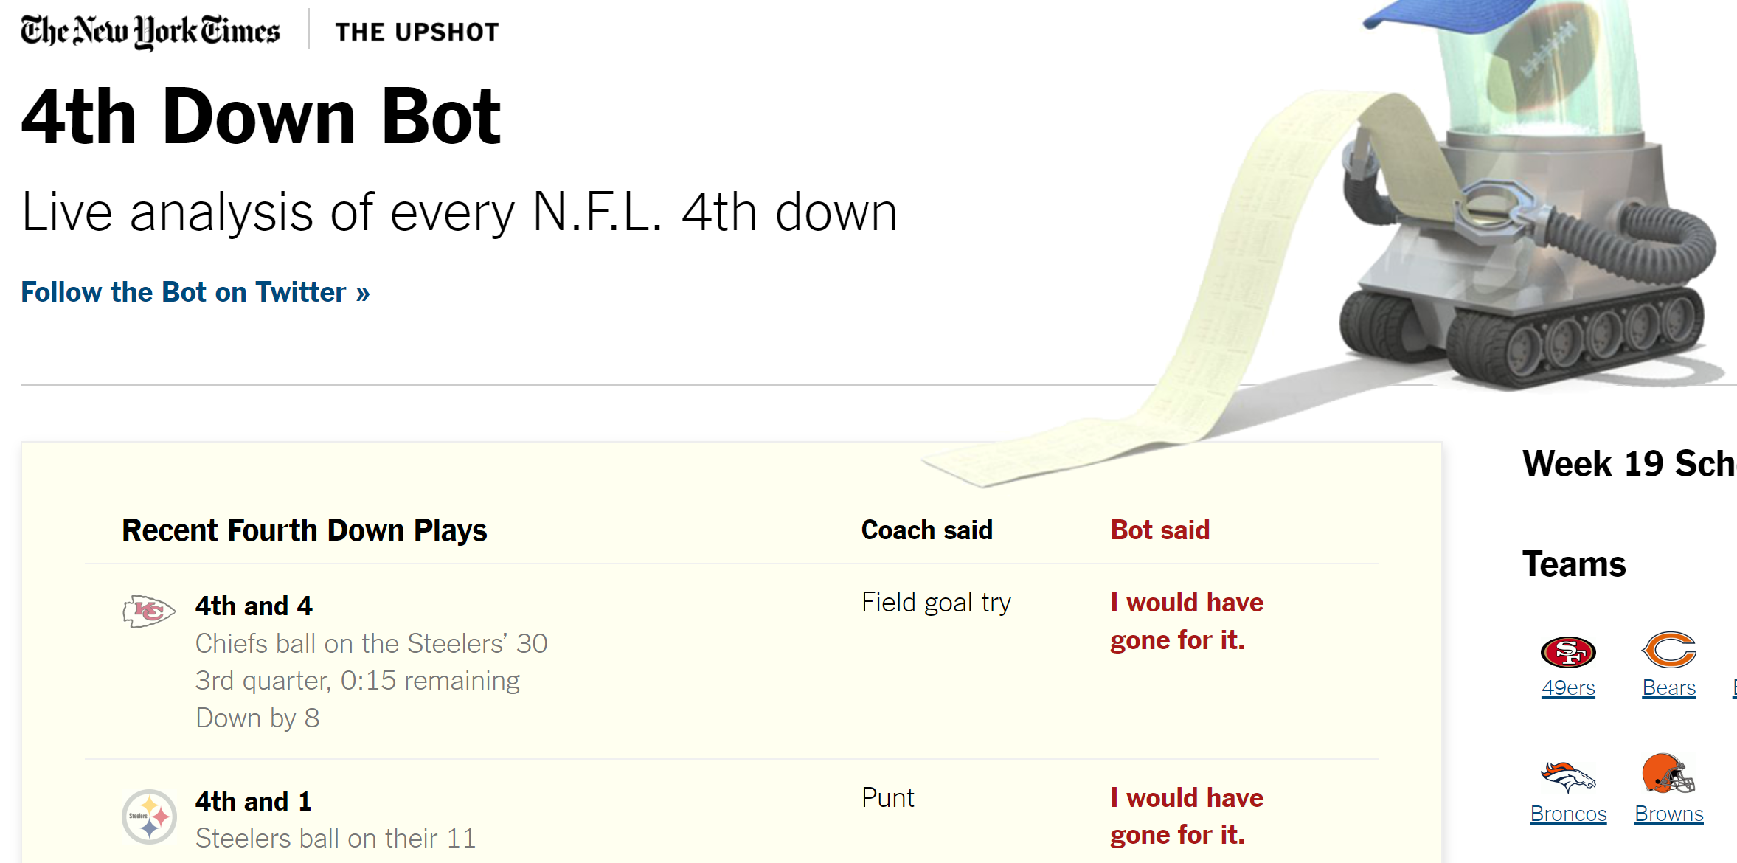
Forward Optimization
Traditional optimization
Based on the data, what should we do to maximize winning?
`nflfastR` & `nfl4th`
Optimizes decision based on win probability

Slide 7
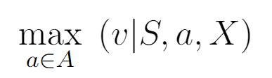
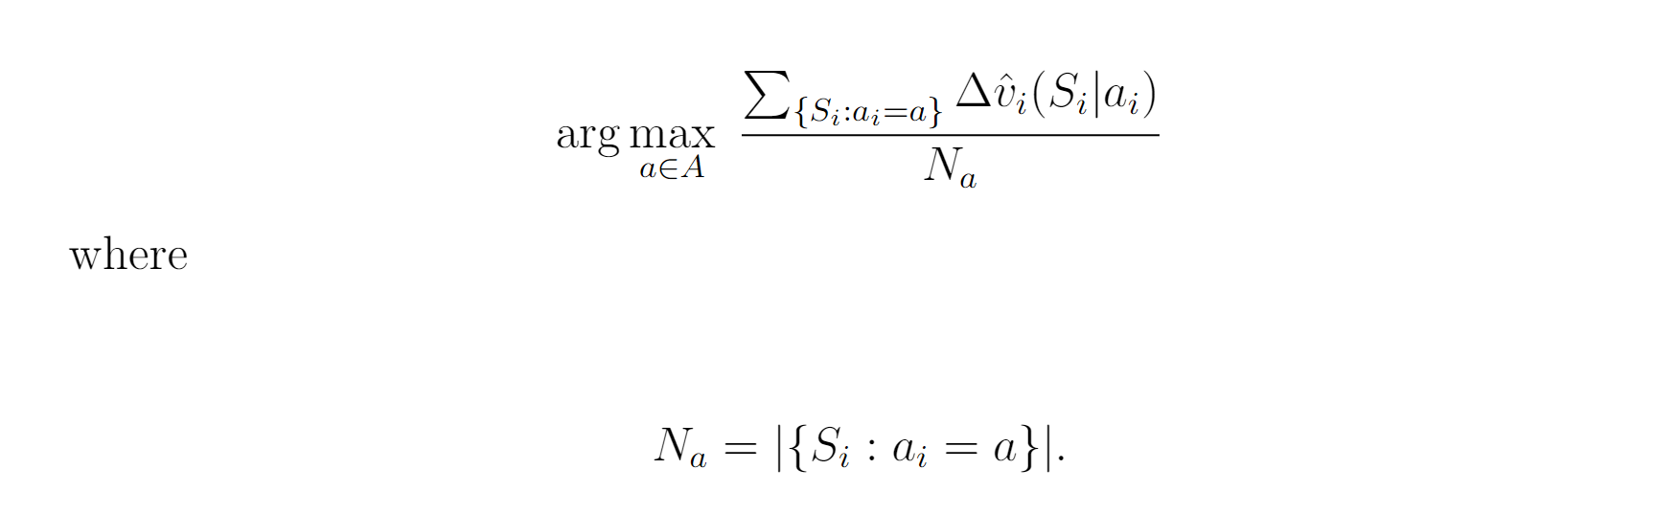
General Objective Function
What we maximize

Slide 8
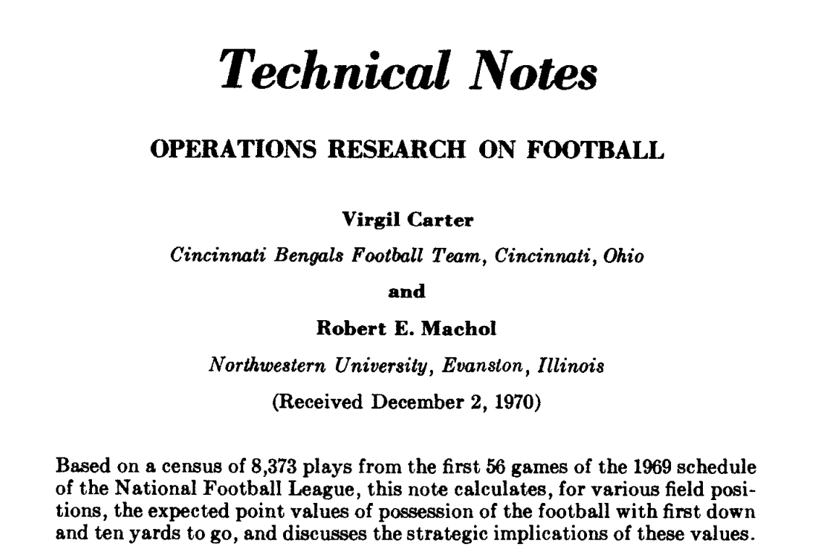
Basis of NFL Analytics
Expected Points (EP)
Expected Points Added (EPA)
Other similar methods of quantifying football:
Win Probability (WP)
Win Probability Added (WPA)
Value Function
Notes:
Virgil carter was a quarterback at BYU in the 60s, studied math, and when he was a quarterback in the NFL for the Cincinnati Bengals at the time of this paper.

Slide 9
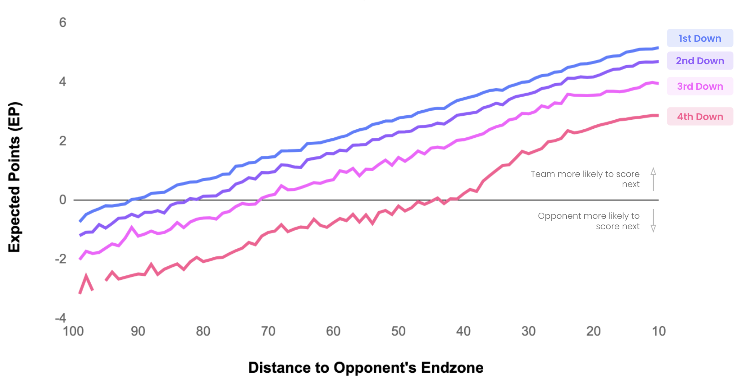

Slide 10
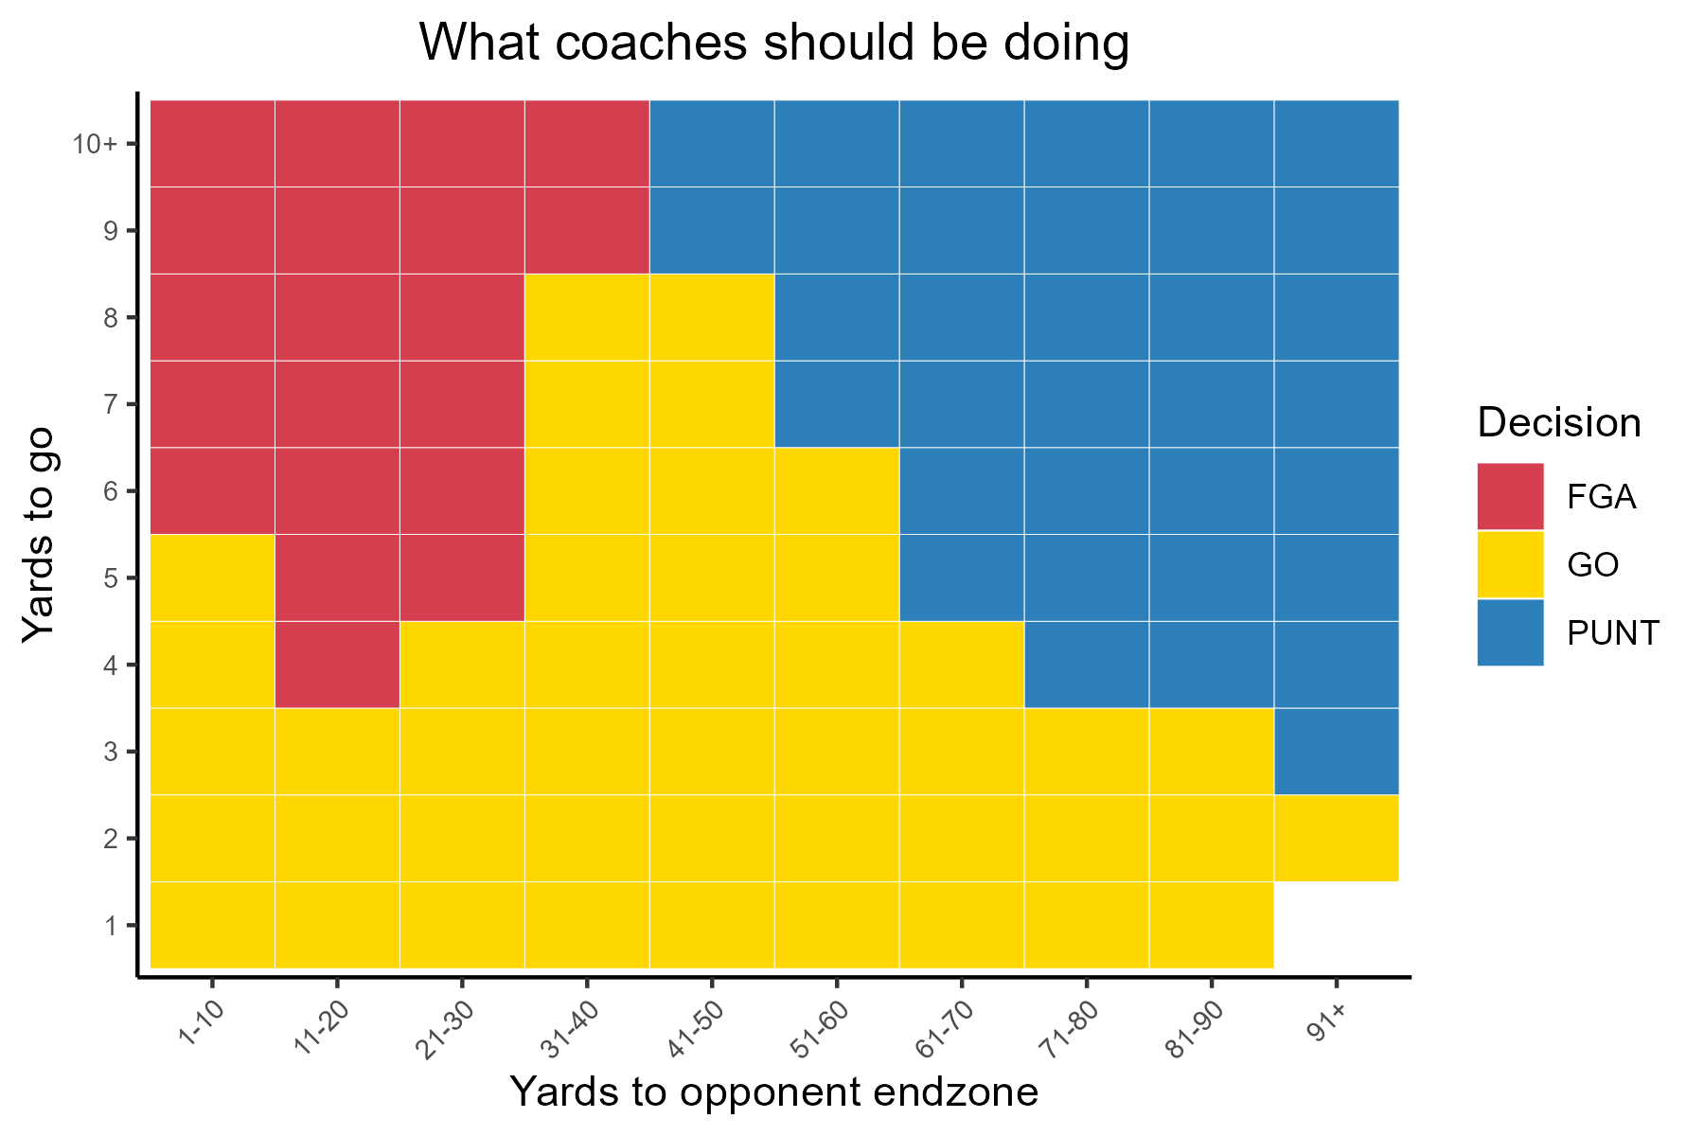

Slide 11
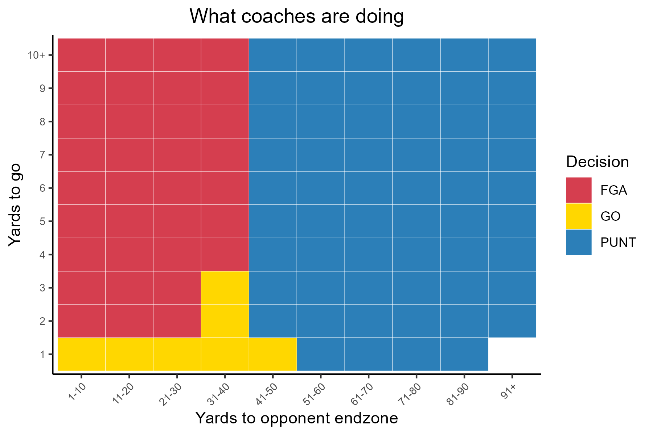

Slide 12
Inverse Optimization
Do Firms Maximize? Romer (2006) proposes two main reasons for this discrepancy.
Objective function not based on winning alone—what other incentives are there besides winning?
Coaches want to optimize winning, but their beliefs about the probabilities are different than the true probabilities
We build on this second reason as motivation for our research.
We treat these coaches beliefs as the estimand of interest
Notes:
First, what is inverse optimization? Broadly, inverse optimization takes decisions as the input and infers the objective function that makes these inputs optimal. It provides a way to explain the gaps between optimization model output recommendations and observed decisions.
Profit maximization, job security, etc.

Slide 13
Our Strategy to infer skewed beliefs
We rely on and assume coaches act optimally based on their biases and in accordance with lived experience.
Can we express a different “empirical" truth than the one in the original data?
Our approach will aim to find a reweighted data set that, when Forward optimized, instead expresses that the coaches' current actions are in line with the most advantageous decision based on Expected Points.

Slide 14
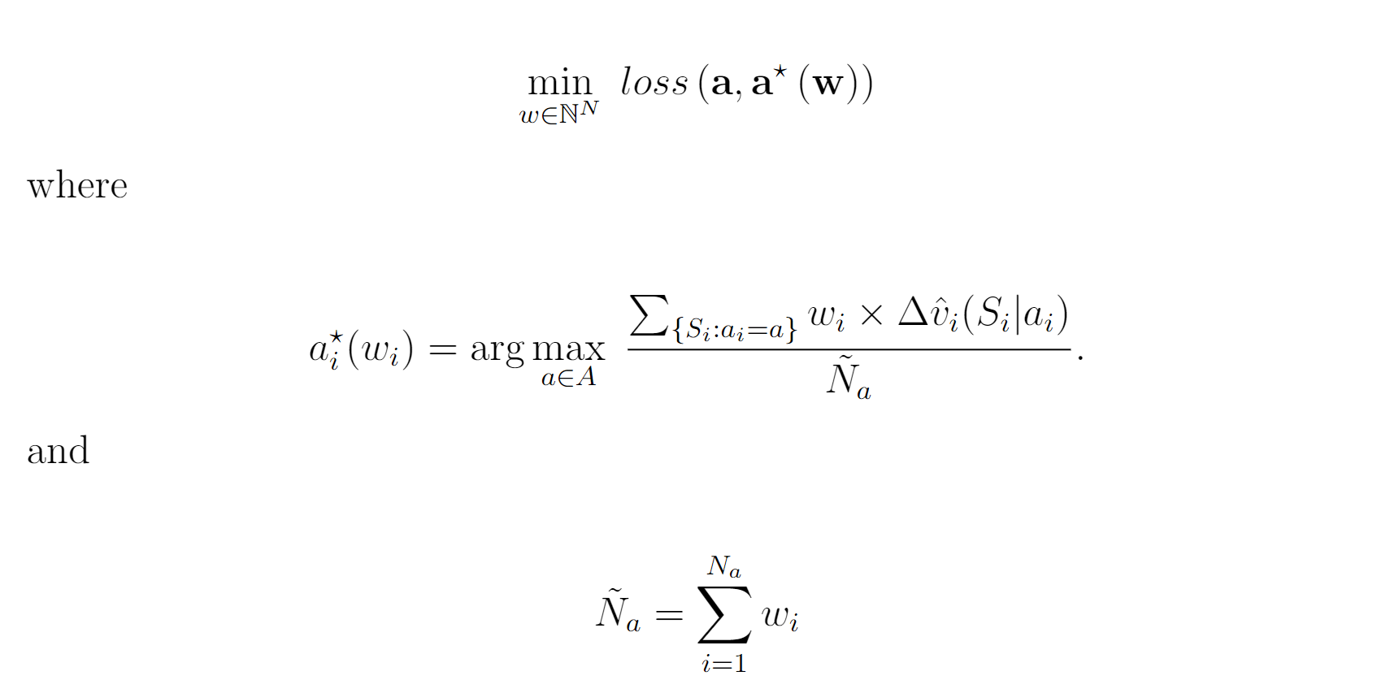
Inverse Optimization Structure

Slide 15
Inverse Toy Problem Original Data
Sample Mean
Sample Mean

Slide 16
Inverse Toy Problem Reweighting
Sample Mean
Sample Mean

Slide 17

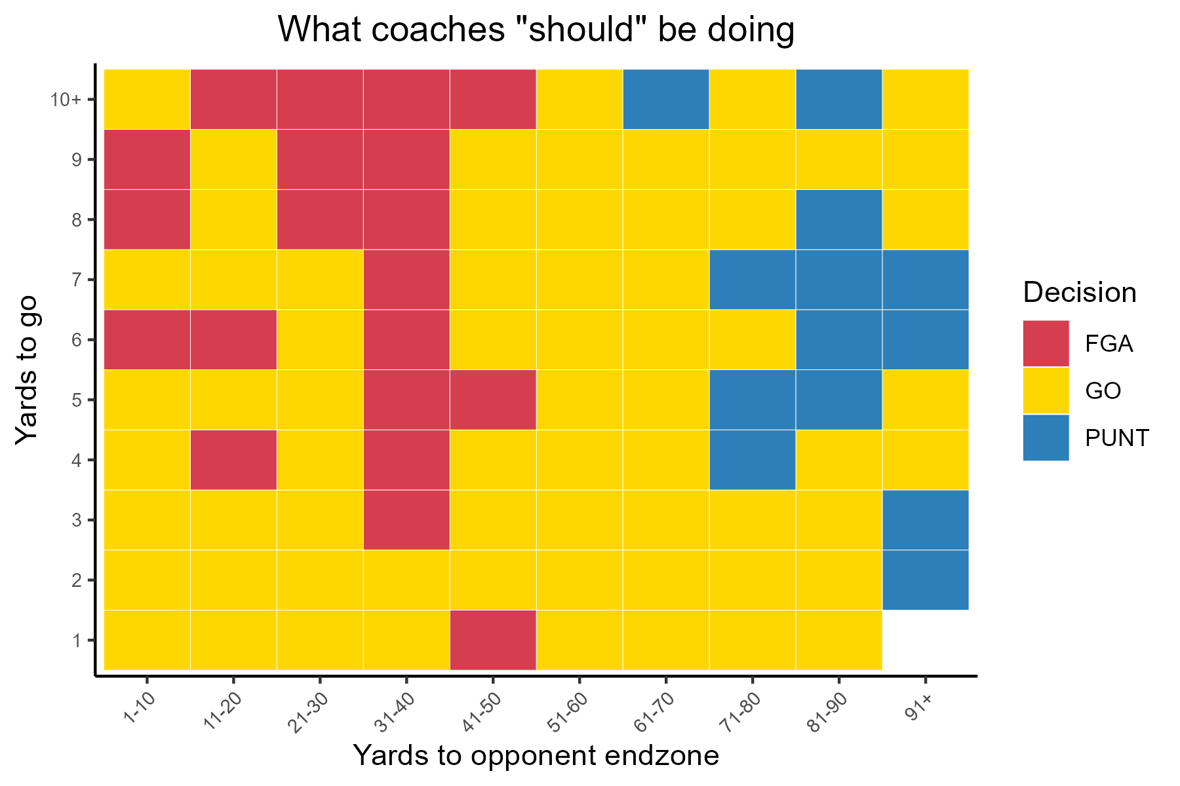

Slide 18
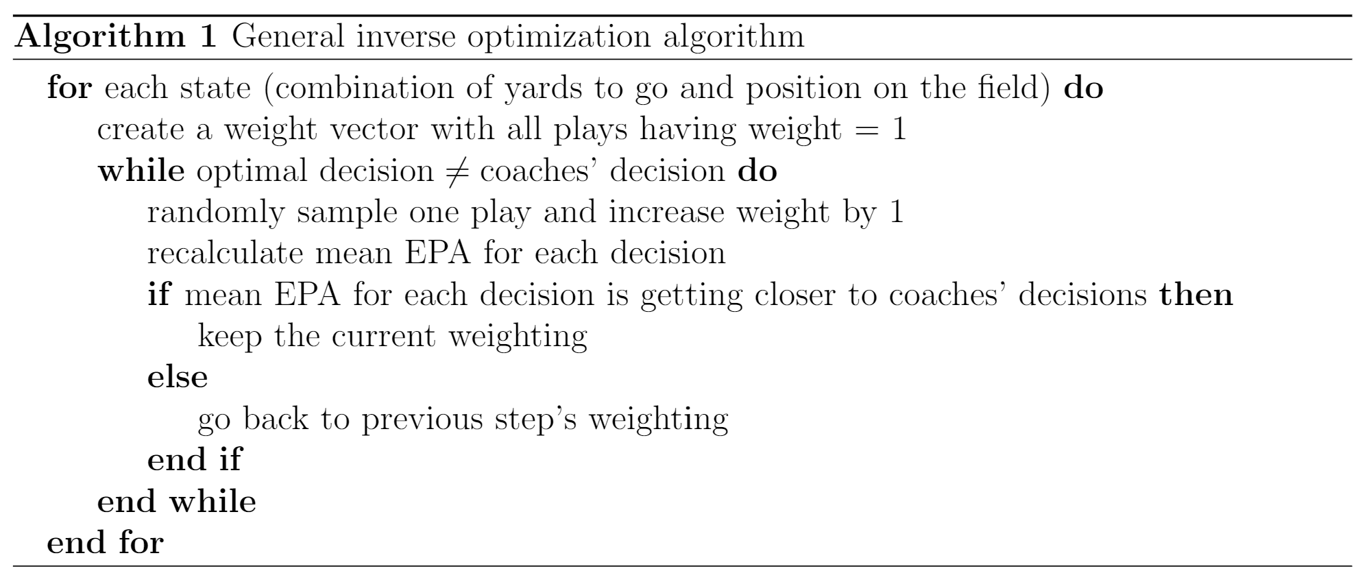
Resampling Algorithm to learn skewed beliefs

Slide 19
Results

Slide 20
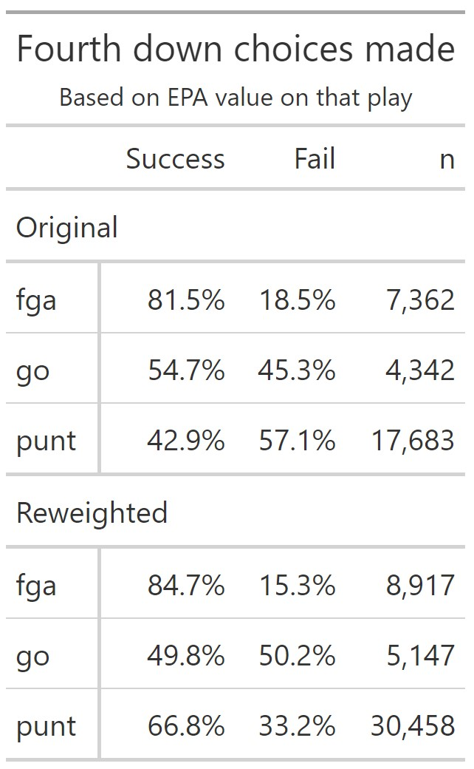

Slide 21
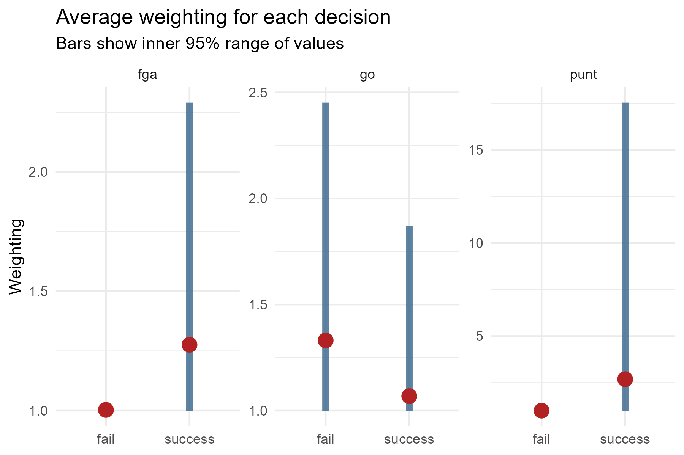

Slide 22
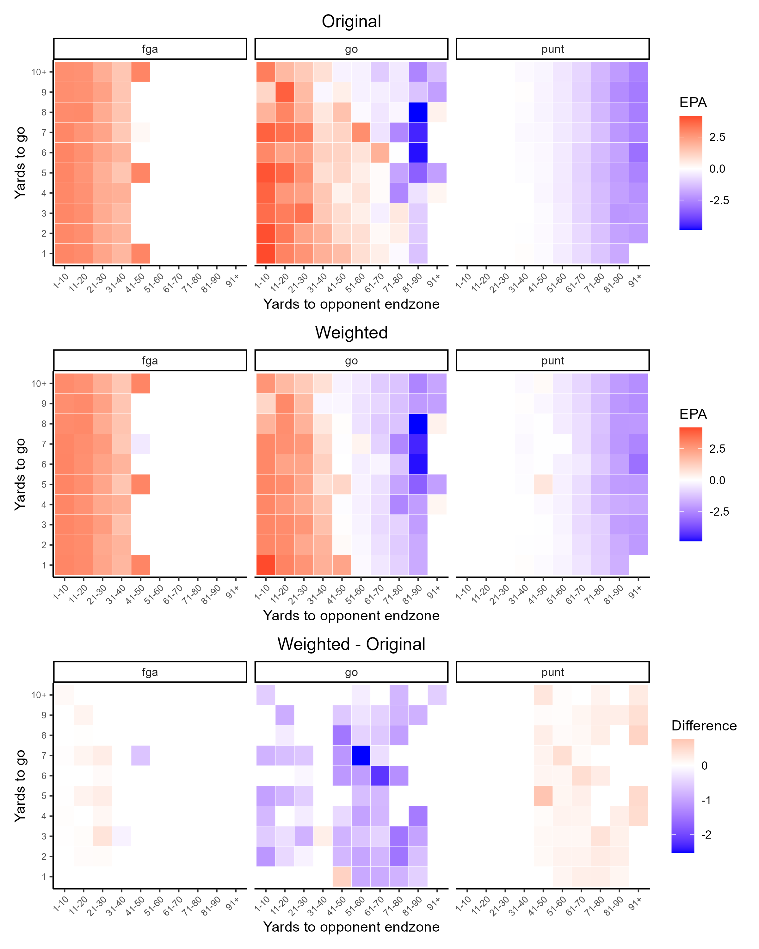

Slide 23
4th Down Upweighting
2 yards to go inside of the 10 yard line
Out of the shotgun, Aaron Rodgers completed a pass short right to Devonte Adams for no gain (upweighted x3)
Out of the shotgun, Justin Herbert completed a pass short right to Keenan Allen for a one yard gain (upweighted x3)

Slide 24
Application and Future work
Understanding
Prior Specification
Apply IO Algorithm to a model
Help coaches, analytics personnel, and others better communicate and understand why decision makers deviate from the analysts’ prescriptions
We can use these weights as priors in an analysis on coaches’ preferences—particularly for areas with small sample sizes
Applying the inverse optimization algorithm to a statistical model would allow more details in a game to be taken into account

